Slide 1
Tricks of the Trade (Stuff that really doesn’t fit anywhere else)
Eric Prebys, FNAL

Slide 2
Multi-stage Acceleration
Early synchrotrons had low energy injection and provided all the acceleration in a single stage.
The energy range of a single synchrotron is limited by
An aperture large enough for the injected beam is unreasonably large at high field.
Hysteresis effects result in excessive nonlinear terms at low energy (very important for colliders)
Typical range 10-20 for colliders, larger for fixed target
Fermilab Main Ring: 8-400 GeV (50x)
Fermilab Tevatron: 150-980 GeV (6.5x)
LHC: 400-7000 GeV (17x)
The highest energy beams require multiple stages of acceleration, with high reliability at each stage
How is this done?

Slide 3
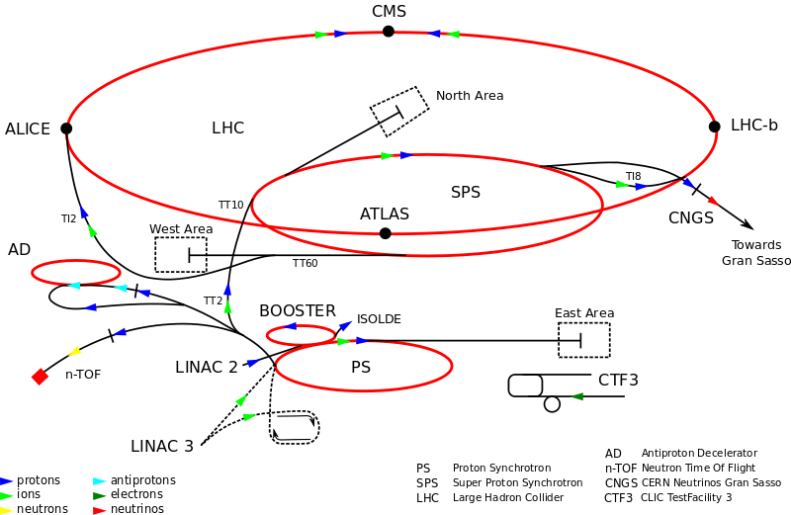
Example: CERN Accelerator Complex
~7 TeV
400 GeV
1.4 GeV
26 GeV
50 MeV

Slide 4
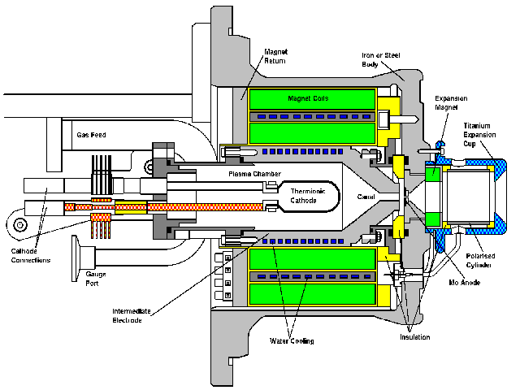
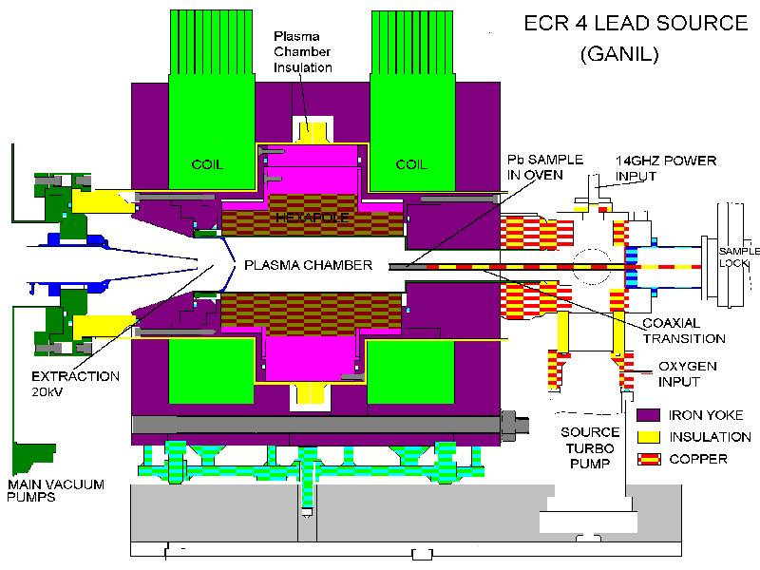
Getting Started: Ion Sources
CERN proton source
CERN Lead source
FNAL H- source. Mix Cesium with Hydrogen to add electron. (why? we’ll get to that)
Typically 10s of keV and mAs to 10s of mA of current. Want to accelerate as fast as possible before space charge blows up the beam!

Slide 5
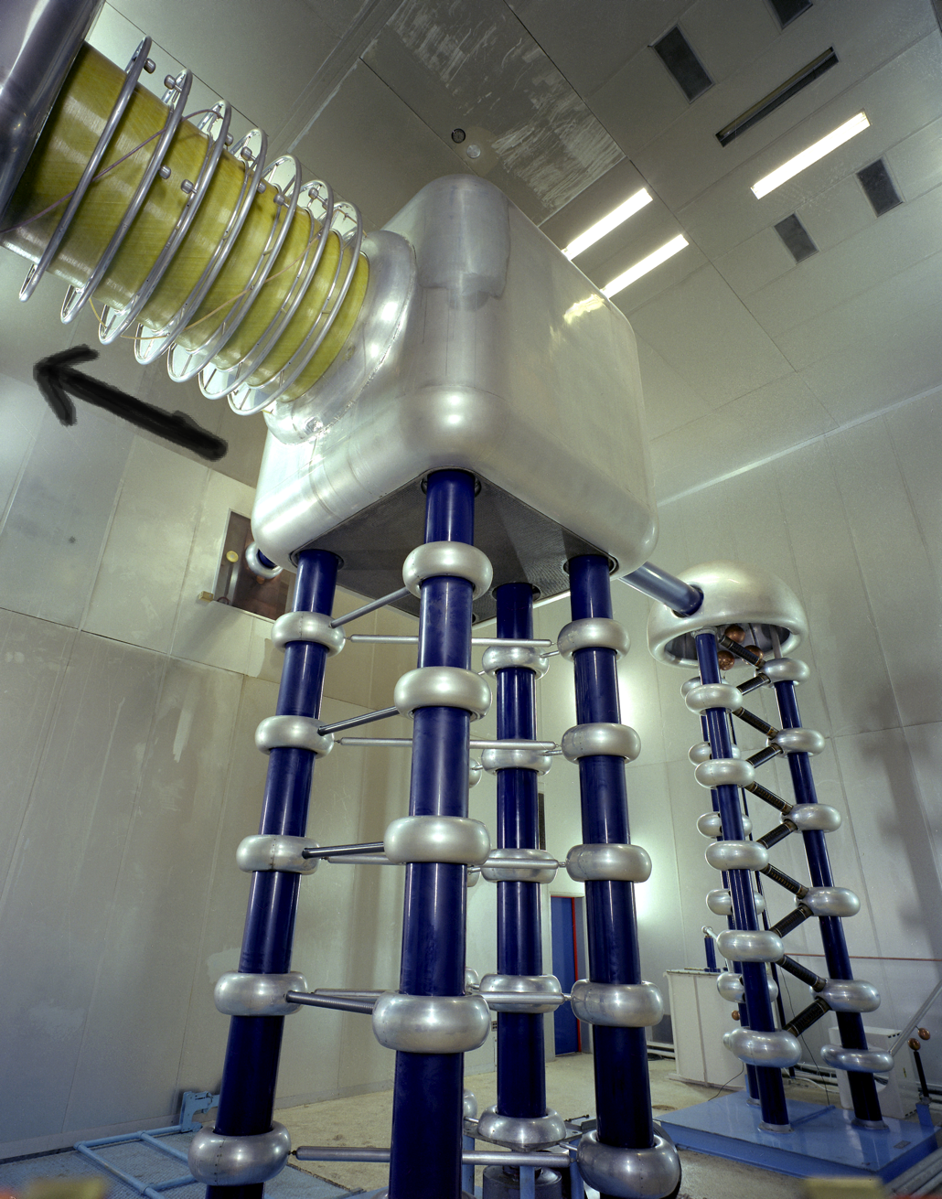
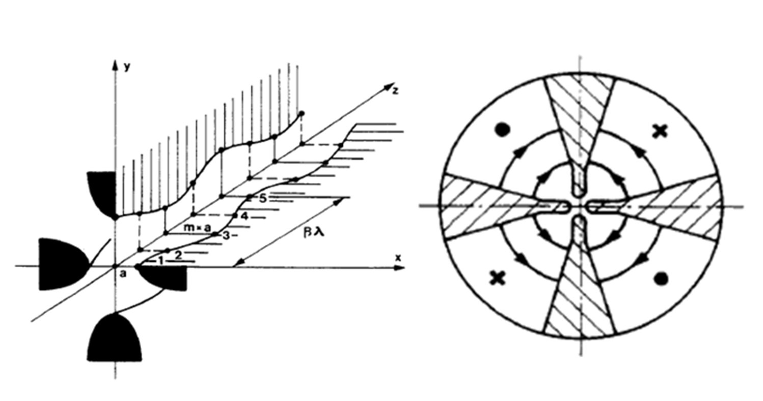
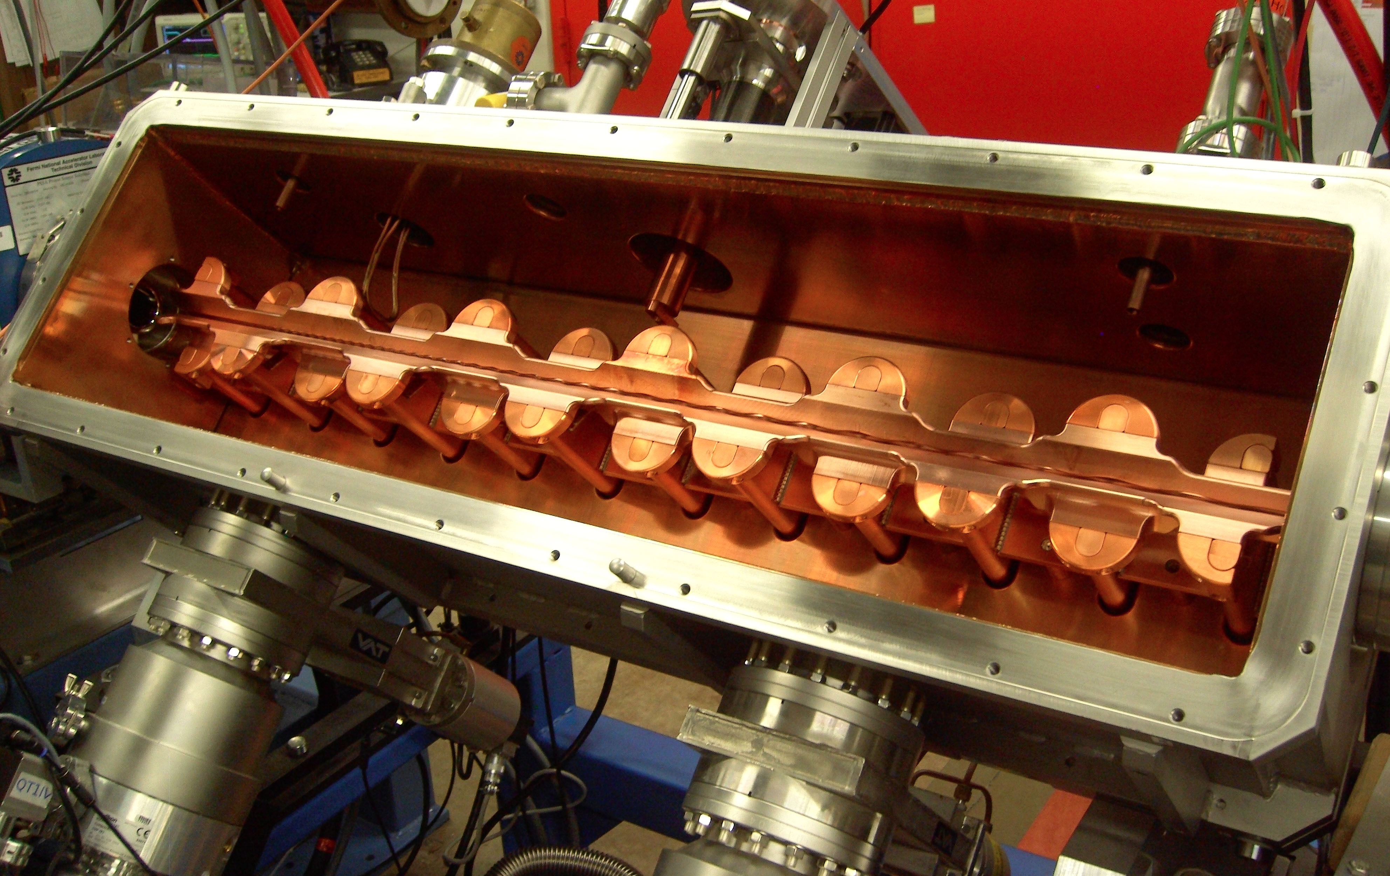
Initial Acceleration
Old: Static
New: RF Quadrupole (RFQ)
Static acceleration from Cockcroft-Walton. FNAL = 750 keV
max ~1 MeV
RF structure combines an electric focusing quadrupole with a longitudinal accelerating gradient.

Slide 6
Early Stages
The front end of any modern hadron accelerator looks something like this (Fermilab front end)
200 MHz RFQ: 35➔750 keV
Solenoidal focusing for low energy beam
Redundant H⁻ sources: 0-35 keV
Medium Energy Beam Transport (MEBT, pronounced “mebbit”): 750 kEV
Low Energy Beam Transport (LEBT, pronounced “lebbit”): 35 keV

Slide 7
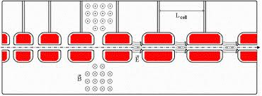
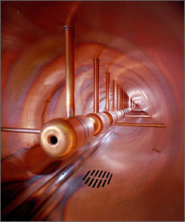
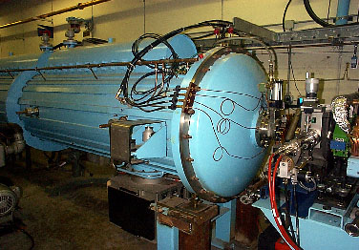
Drift Tube (Alvarez) Cavity
Because the velocity is changing quickly, the first linac is generally a Drift Tube Linac (DTL), which can be beta-matched to the accelerating beam.
Put conducting tubes in a larger pillbox, such that inside the tubes E=0
As energy gets higher, switch to “pi-cavities”, which are more efficient
Bunch of pillboxes
Gap spacing changes as velocity increases
Drift tubes contain quadrupoles to keep beam focused
➔
Fermilab low energy linac
Inside

Slide 8
Linac -> Synchrotron Injection
Eventually, the linear accelerator must inject into a synchrotron
In order to maximize the intensity in the synchrotron, we can
Increase the linac current as high as possible and inject over one revolution
There are limits to linac current
Inject over multiple (N) revolutions of the synchrotron
Preferred method
Unfortunately, Liouville’s Theorem says we can’t inject one beam on top of another
Electrons can be injected off orbit and will “cool” down to the equilibrium orbit via synchrotron radiation.
Protons can be injected a small, changing angle to “paint” phase space, resulting in increased emittance
Linac emittance
Synchrotron emittance

Slide 9
Ion (or Charge Exchange) Injection
Magnetic chicane pulsed to move beam out during injection
Circulating Beam
Beam at injection
H⁻ beam from LINAC
Stripping foil
Instead of ionizing Hydrogen, and electron is added to create H⁻, which is accelerated in the linac
A pulsed chicane moves the circulating beam out during injection
An injected H⁻ beam is bent in the opposite direction so it lies on top of the circulating beam
The combined beam passes through a foil, which strips the two electrons, leaving a single, more intense proton beam.
Fermilab was converted from proton to H⁻ during the 70’s
CERN still uses proton injection, but is in the process of upgrading (LINAC4 upgrade)

Slide 10
Injection and Extraction
We typically would like to extract (or inject) beam by switching a magnetic field on between two bunches (order ~10-100 ns)
Unfortunately, getting the required field in such a short time would result in prohibitively high inductive voltages, so we usually do it in two steps:
fast, weak “kicker”
slower (or DC) extraction magnet with zero field on beam path.

Slide 11
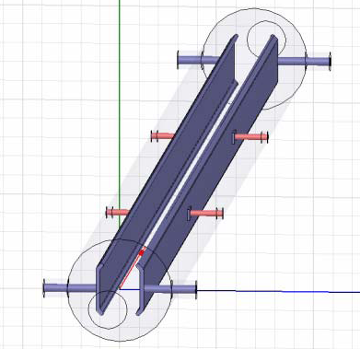
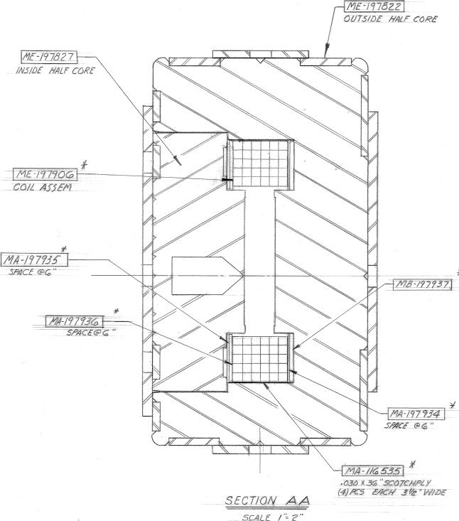
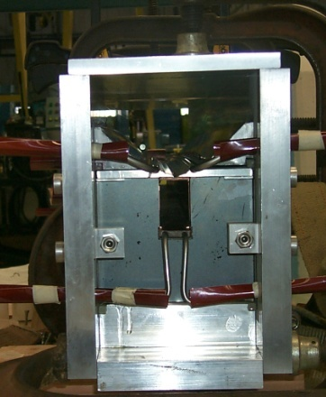
Extraction Hardware
“Fast” kicker
usually an impedance matched strip line, with or without ferrites
“Slow” extraction elements
“Lambertson”: usually DC
Septum: pulsed, but slower than the kicker
circulating beam (B=0)
circulating beam (B=0)
B
current “blade”
B
return path

Slide 12
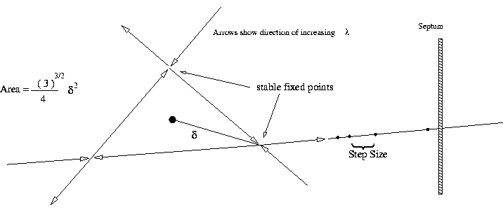
Slow Extraction (not important for colliders)
Sometimes fixed target experiments want beam delivered slowly (difficult)
To do this, we generate a harmonic resonance
Usually sextupoles are used to create a 3rd order resonant instability
Tune the instability so the escaping beam exactly fills the extraction gap between interceptions (3 times around for 3rd order)
Minimum inefficiency ~(septum thickness)/(gap size)
Use electrostatic septum made of a plane of wires. Typical parameters
Septum thickness: .1 mm
Gap: 10 mm
Field: 80 kV
particle flow
E
Particles will flow out of the stable region along lines in phase space into an electrostatic extraction field, which will deflect them into an extraction Lambertson

Slide 13
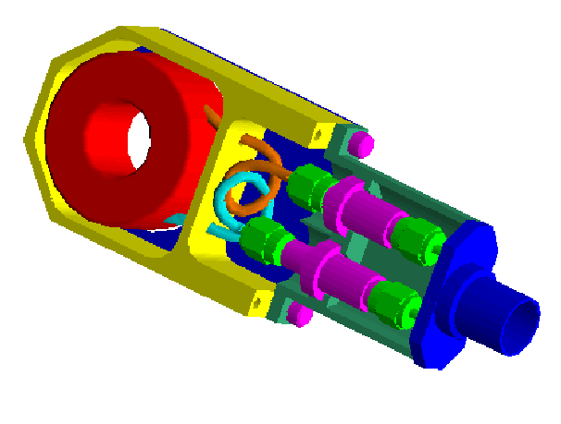
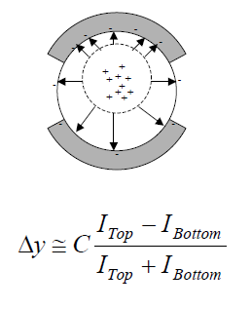
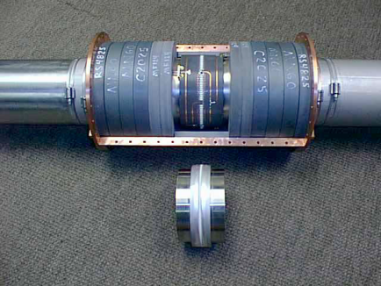
Standard Beam Instrumentation
Bunch/beam intensity are measured using inductive toriods
Beam position is typically measured with beam position monitors (BPM’s), which measure the induced signal on a opposing pickups
Longitudinal profiles can be measured by introducing a resistor to measure the induced image current on the beam pipe -> Resistive Wall Monitor (RWM)

Slide 14
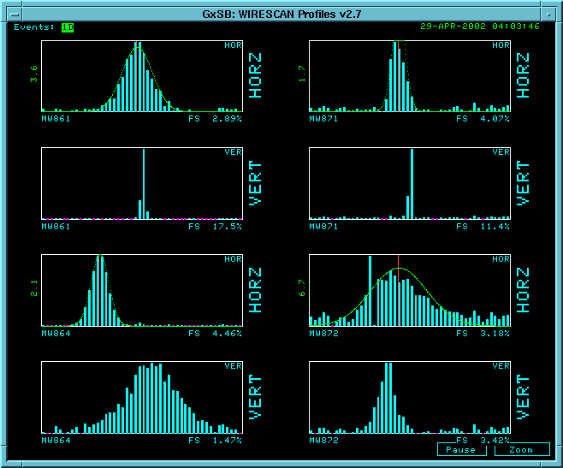
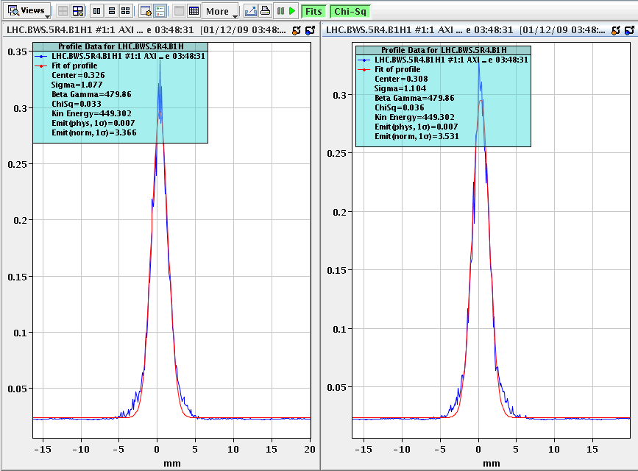
Beam Instrumentation (cont’d)
Beam profiles in beam lines can be measured using secondary emission multiwires (MW’s)
Can measure beam profiles in a circulating beam with a “flying wire scanner”, which quickly passes a wire through and measures signal vs time to get profile
Non-destructive measurements include
Ionization profile monitor (IPM): drift electrons or ions generated by beam passing through residual gas
Synchrotron light
Standard in electron machines
Also works in LHC
Beam profiles in MiniBooNE beam line
Flying wire signal in LHC

Slide 15
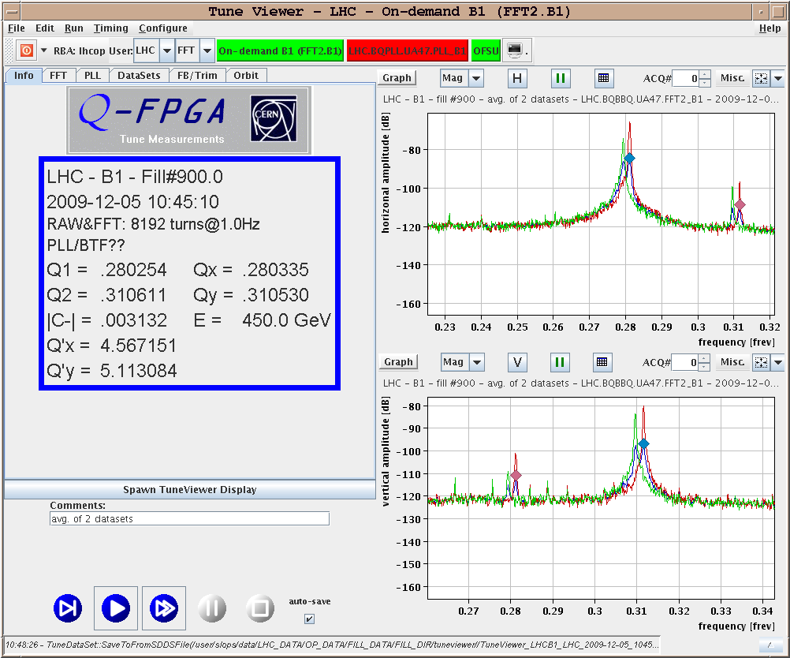
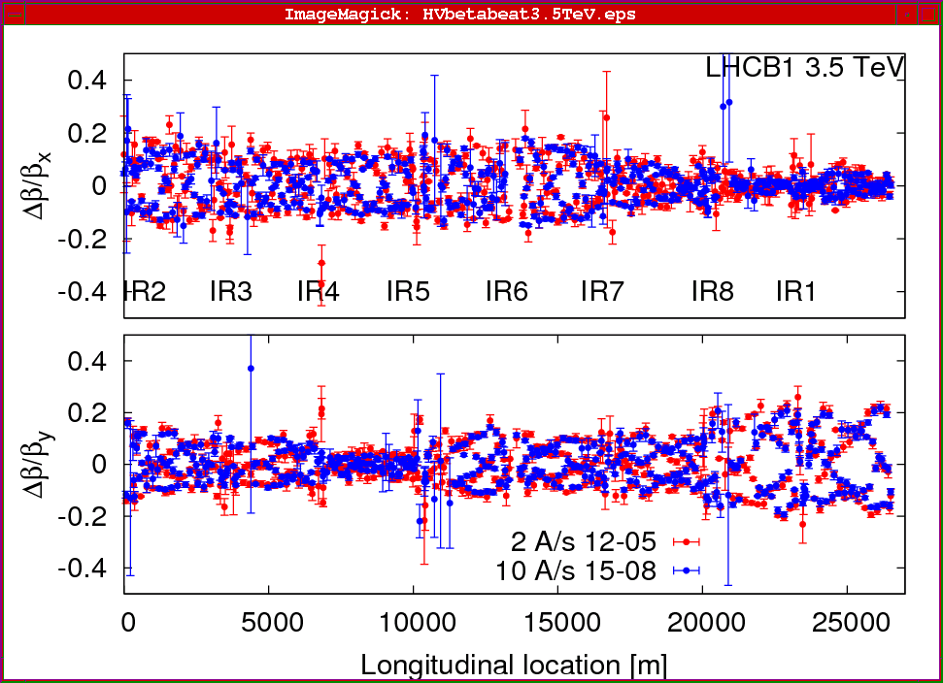
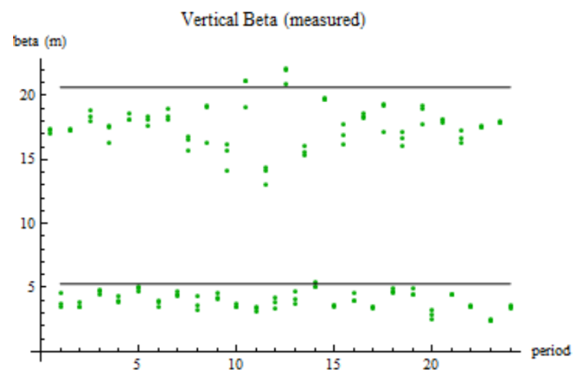
Measuring Lattice Parameters
The fractional tune is measured by Fourier Transforming signals from the BPM’s
Sometimes need to excite beam with a kicker
Beta functions can be measured by exciting the beam and looking at distortions
Can use kicker or resonant (“AC”) dipole
Can also measure the by functions indirectly by varying a quad and measuring the tune shift

Slide 16
Colliding Beam Luminosity
Circulating beams typically “bunched”
(number of interactions)
Cross-sectional area of beam
Total Luminosity:
Circumference of machine
Number of bunches
crossing rate

Slide 17
Luminosity of Colliding Beams
Particles in a bunch
For equally intense Gaussian beams
Using we have
Collision frequency
Geometrical factor: - crossing angle - hourglass effect
Transverse size (RMS)
prop. to energy
Normalized emittance
Revolution frequency
Betatron function at collision point ➔ want a small β*!
Number of bunches
Particles in bunch
Record e+e- Luminosity (KEK-B): 2.11x10³⁴ cm⁻²s⁻¹ Record p-pBar Luminosity (Tevatron): 4.06x10³² cm⁻²s⁻¹ Record Hadronic Luminosity (LHC): 7.0x10³³ cm⁻²s⁻¹ LHC Design Luminosity: 1.00x10³⁴ cm⁻²s⁻¹

Slide 18
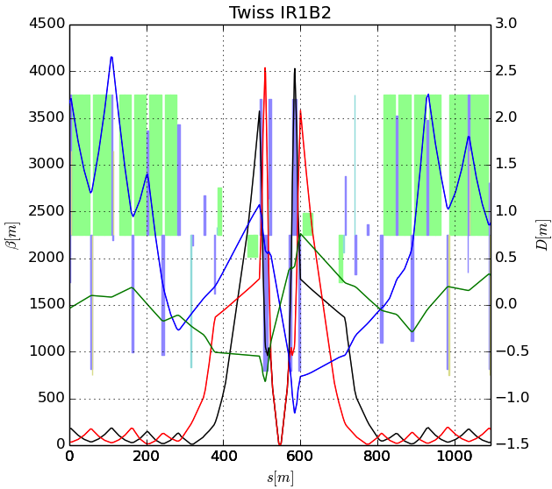
Limits to β*
β
s
➔ small β* means large β (aperture) at focusing triplet

Slide 19
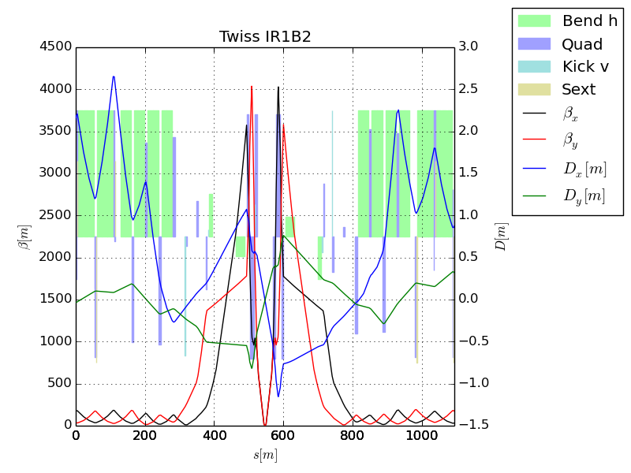
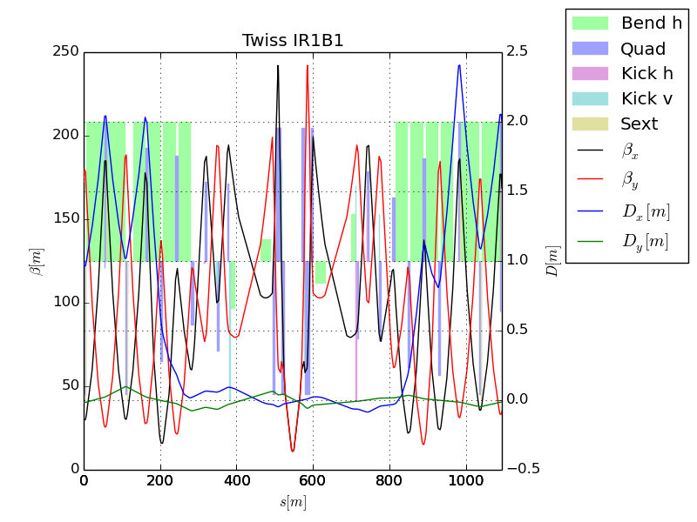
The “Squeeze”?
In general, synchrotrons scale all magnetic fields with the momentum, so the optics remain constant – with one exception.
Recall that because of adiabatic damping, beam gets smaller as it accelerates.
This means all apertures must be large enough to accommodate the injected beam.
This a problem for the large β values in the final focus triplets
For this reason, injection optics have a larger value of β*, and therefor a smaller value of β in the focusing triplets.
After acceleration, beam is “squeezed” to a smaller β* for collision
factor of ~4 for LHC

Slide 20
Orbit correction
Generally, beam lines or synchrotrons will have beam position monitors (BPM’s) and correction dipoles (trims)
We would like to use the trims to cancel out the effect of beamline imperfectins, ie
Can express this as a matrix and invert to solve with standard techniques
If n=m, can just invert
If n>m, can minimize RMS
Cancel displacement at BPM i due to imperfections
Setting of trim j

Slide 21
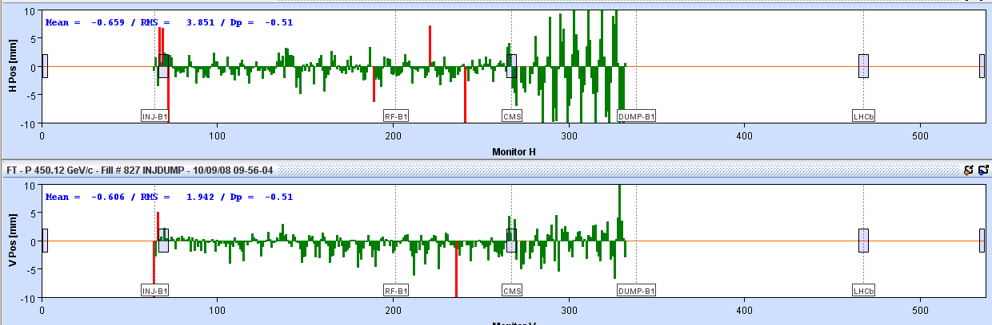
Example: First Beam through LHC (Sept. 10, 2008)
General procedure
Proceed one octant at a time, closing collimators at the next point.
Measure the deviations from an ideal orbit, and calculate corrections
Might need to iterate a few times
Beam 1 direction
New sector before correction
After correction

Slide 22
Beam Collimation and Machine Protection
As beams get more intense, machine protection becomes very important
Full LHC energy ~ 150 sticks of dynamite!
Beam halo is generally cleaned up through multi-stage collimation

Slide 23
Secondary Beams
When a proton beam strikes a target, the energy of the beam goes into particle production. Charged particles include (in ~descending order of population)
π±: Most of the energy
K±: Charged particles containing a Strange quark
p: ordinary protons
e±: These mostly come from neutral pions that immediately decay to two photons.
Antiprotons:
Other strange “hyperons”
When and electron beam strikes a target, it makes mostly photons and e±
Positron production targets can be very efficient.
Generally, we design secondary beam lines to maximize acceptance of the species of beam we’re looking for.

Slide 24
Special Case: Neutrino Beams
Electron neutrinos are generally produces in nuclear reactors. High energy particle beams are used to produce primarily muon neutrinos in the reactions
Select correct neutrino species by focusing correct pion species
Leading particles

Slide 25
Neutrino Horns
Neutrino horns work by producing an coaxial current so the correct sign pions are focused in both planes.
This is then followed by a decay region to allow the pions to decay

Slide 26
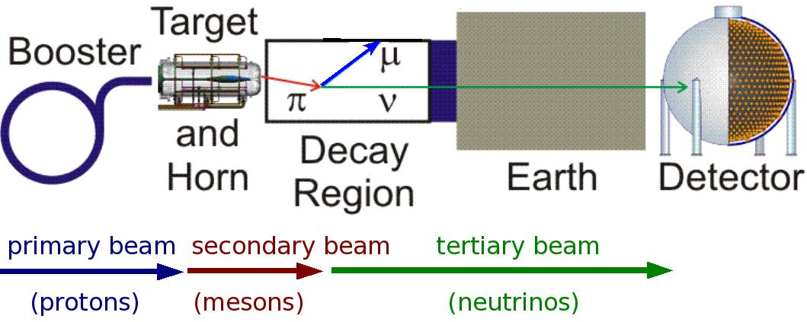
Example: MiniBooNE Neutrino Line
(not to scale!)

Slide 27
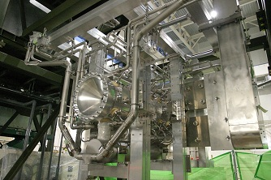
Practical Considerations
Neutrino horns operate in fierce radiation environments, and are pulsed with currents of several hundred kA.
They require water cooling and sophisticated mechanical analyses.
Neutrino Horn Assembly at J-Parc

Slide 28
Antiproton Beams
Antiprotons are produced in very small numbers in proton collisions.
In order to be useful, these must be captured and “cooled” (i.e. have their area in phase space reduced).
Although high energy proton-antiproton colliders are a thing of the past (homework problem), anti-protons are still of great interest at low energy:
CERN LEAR facility
FAIR Facility in Germany.

Slide 29
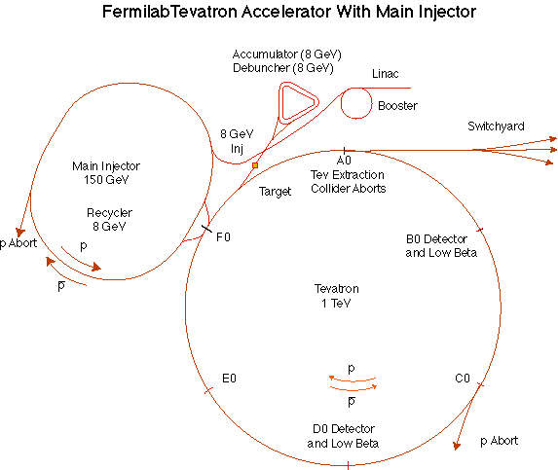
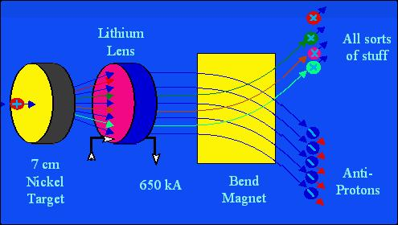
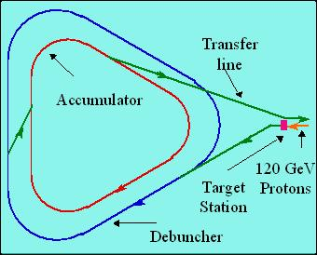
Highest Intensity Antiproton Source: Fermilab
120 GeV protons strike a target, producing many things, including antiprotons.
a Lithium lens focuses these particles (a bit)
a bend magnet selects the negative particles around 8 GeV. Everything but antiprotons decays away.
The antiproton ring consists of 2 parts
– the Debuncher – the Accumulator.

Slide 30
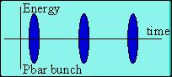
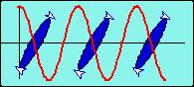
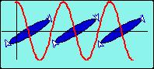
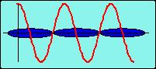
Antiproton Source – debunching
Particles enter with a narrow time spread and broad energy spread.
High (low) energy pbars take more (less) to go around…
…and the RF is phased so they are decelerated (accelerated),
resulting in a narrow energy spread and broad time spread.
At this point, the pBars are transferred to the accumulator, where they are “stacked”

Slide 31
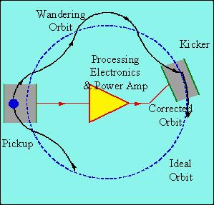
Stochastic cooling of antiprotons
Positrons will naturally “cool” (approach a small equilibrium emittance) via synchrotron radiation.
Antiprotons must rely on active cooling to be useful in colliders.
Principle: consider a single particle which is off orbit. We can detect its deviation at one point, and correct it at another:
But wait! If we apply this technique to an ensemble of particles, won’t it just act on the centroid of the distribution? Yes, but…
Stochastic cooling relies on “mixing”, the fact that particles of different momenta will slip in time and the sampled combinations will change.
Statistically, the mean displacement will be dominated by the high amplitude particles and over time the distribution will cool.
Simon Van der Meer won the Nobel Prize for this.

Slide 32
Electron Cooling
Electron cooling works by injecting “cold electrons” into a beam of negative ions (antiprotons or other) and cooling them through momentum exchange.
Layout
ion beam
electron gun
electron decelerator and collector
Want

Slide 33
The electrons act like a drag force on the ions. At low velocity, the ionization loss varies as
The velocity spread of the electrons is dominated by the energy distribution out of the cathode. In the rest frame, motion is non-relativistic
relative velocity
Energy spread. Typically ~.5 eV

Slide 34
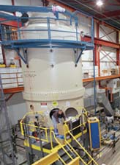
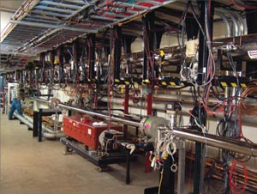
Electron Cooling in the Fermilab Recycler
One of the highest energy and most successful electron cooling systems was in the Fermilab “Recycler” – an 8 GeV permanent storage ring which was used to store anti-protons for use in the Tevatron collider.
pelletron
.5 A “u-beam”

